Slide 1
RESEARCH METHODS IN COMPUTER SCIENCE
(CSC 476)
WEEK SEVEN

Slide 2
Contents:
Project Proposal
Research Project Format
  Title page
  Approval or Certification page
  Dedication
  Acknowledgement
  Table of content
  List of tables
  List of figures
  List of symbols/nomenclature(where applicable)
  Abstract
  Main work (Chapters 1-5)
    Chapter One: Introduction
    Chapter Two: Literature Review
    Chapter Three: Methodology
    Chapter Four: Result Presentation and Discussion
    Chapter Five: Summary, Conclusion, and Recommendation
  References
  Appendices(where applicable)

Slide 3
Project Proposal
Submitting a project proposal marks the initial stage of project development, and the proposed topic should include the following sections:
  The Title of the project, student’s name and matriculation number
  A brief but comprehensive description of background to the project. This section can contain some literature reviews.
  Problem statement
  Aim and objectives (milestones)
  Brief description of methodology to be adopted, with an illustrative model diagram.
  Software or algorithm and hardware to be employed
  Assumptions made on the project (if available)
  Justification for the project
  A list of references.

Slide 4
Research Project Format
  Title page
  Approval or Certification page
  Dedication
  Acknowledgement
  Table of content
  List of tables
  List of figures
  List of symbols/nomenclature(where applicable)
  Abstract
  Main work (Chapters 1-5)
  References
  Appendices(where applicable)

Slide 5
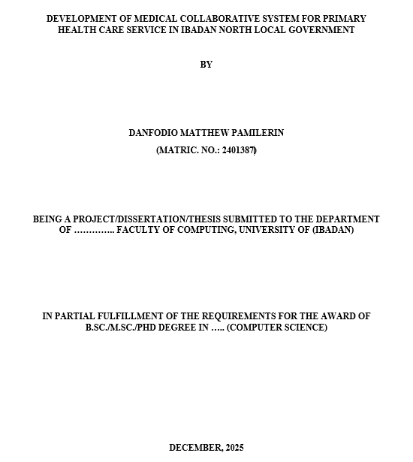
Title Page
This opening page presents key details about the project, dissertation, or thesis, including the title, author, purpose, and date.

Slide 6
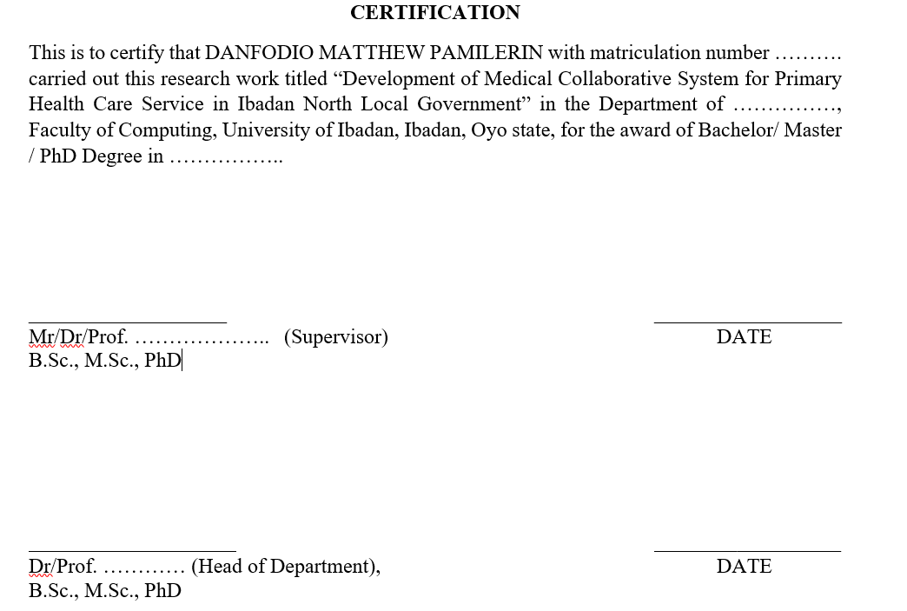
Certification or Approval Page
It includes the institution and department, along with a declaration confirming approval of the work by the supervisor, head of department, and external examiner, with designated spaces for their signatures.

Slide 7
Dedication
This section of the project allows the student to dedicate the work to individuals or entities of personal significance, such as God, friends, a spouse, parents, children, or ancestors.
This section is where the researcher expresses gratitude to individuals or groups who supported and contributed to the successful completion of the study.
Acknowledgement

Slide 8
Tips on Writing a Good Acknowledgement
Maintain an academic tone; avoid journalistic style or overly devotional language.
Do not use the section for excessive praise or flattery.
Exclude informal or non-academic expressions.
Keep the language simple and clear; avoid overly decorative wording.
Ensure all names are spelled accurately.
First paragraph: Mention the institution where the study was carried out, as well as the libraries and other locations consulted for data collection.
Second paragraph: Acknowledge the department, beginning with the supervisor, followed by lecturers within and outside the department who contributed to your academic growth. List names appropriately, starting with professors and including initials, and recognize those who assisted with the research.
Final paragraph: Briefly recognize sponsors and close family members (such as spouse, children, or siblings) where relevant, in one or two sentences.

Slide 9
Table of Content
The table of contents presents all major headings, subheadings, and their corresponding page numbers, serving as a guide to the structure of the research. It makes locating and referencing sections easier. It should be finalized after completing the entire work to ensure that all sections are accurately included.
Tips: Table of Content
  It is the list that contains ALL the Front Matter, Main Content and Back Matter of the Project/Dissertation/Thesis.
  Front Matter includes; Certification page, Dedication Page, Acknowledgement page, Abstract page and Table of Contents
  Main Content includes; Chapters, Sub-headings and Endnotes at the end of each Chapter
  Back Matter includes; Bibliography (to be sub-divided into Books, Internet, Journals, Magazines, Newspapers, Periodicals, Proceedings, Unpublished Thesis,), Appendix(ces), Bio-data (CV format), and the University Compliance Form or Ethical Approval (if needed in the study).
  It is the LAST thing to be completed so that it is 100% accurate.
  It should be easy to read and accurately formatted.
  Headings and page numbers of all the front matter, main content and back matter should align with the body of the work.

Slide 10
The Research Process
This section helps readers easily find tables, figures, or symbols within the work. It should include their identification numbers, clear descriptive titles, and corresponding page numbers. The entries must be properly organized and clearly presented, while all tables and figures in the main text should be accurately labeled.
Example: List of Tables
Table Title Page
1.1 Knowledge Base Domain system 5
2.1 Accumulation of power and integrity 10
3.1 Standard deviation and its cohorts 44
4.1 Systematic review of functions 76
Example: List of Figures
Figures Title Page
1.1 Hierarchy of Power Shift 34
1.2 Domain Name System 45
1.3 System analysis and design 68

Slide 11
List of Acronyms
Abbreviations Meaning
USA United State of America
GDPR General Data Protection Regulation

Slide 12
Abstract
An abstract provides a brief summary of a research paper or project, usually presented in a single paragraph of about 150–250 words (roughly 6–7 sentences). A well-written abstract serves several purposes:
  It allows readers to quickly grasp the core idea of the study and decide whether to read the full work.
  It prepares readers for the detailed information, analysis, and arguments that follow in the main text.
  It also helps readers remember the key points of the study after reading.
The abstract should be written as a single paragraph and kept within the specified word limit, although some institutions may allow it to be structured into four paragraphs. Regardless of the format, it should include the following elements:
  A brief background or context of the study, along with its main objective, in one or two sentences.
  The research gap and theoretical basis, highlighting what previous studies have addressed and what remains unexplored, in about two sentences.
  The purpose and justification for the study, explaining its importance, whether it addresses a new topic, fills an existing gap, applies new methods, or resolves differing views in the literature.

Slide 13
Abstract …………….
  The methodology employed, including the research design, population, sample and sampling techniques, as well as data collection and analysis methods, summarized in about four sentences.
  The key findings, including relevant values for empirical studies, presented in about two sentences.
  The main conclusion, stated in one sentence.
  The primary recommendation, also presented in one sentence.
An abstract should be clear and understandable on its own, without requiring the reader to consult the full document. It typically avoids citations and focuses on summarizing the study, its findings, and main arguments, while detailed references are included in the main body of the work.

Slide 14
Chapter One: Introduction
It outlines the background, scope, and objectives of the study,
Provides foundation for the entire report.
The researcher should clearly explain the reasons for undertaking the work and present the information in a logical, well-structured sequence, moving from general ideas to more specific details.
It contains the below sub-sections:
  Background of the Study: The background establishes the overall context and direction of the study.
  Problem Statement: Clearly present the specific issue being examined, showing how it arises from existing gaps and how the current study intends to address them.
  Aim and Objectives: Start the aim of the study or project with the phrase: “The aim of this study/project is to…”
  The objectives should be two or more and presented in a numbered list, introduced as: “The objectives of this study/project are to:”
      i. Design and develop a model…
      ii. Assess the performance of the model
      iii. Compare the model with…
Each objective should be clear, attainable, and measurable, supported by an appropriate method, and capable of producing meaningful results.

Slide 15
Chapter One ………….
  Methodology: Provide a concise description of the materials, procedures, and techniques employed in carrying out the study or project.
  Significance/Justification of the Study/Project: This section should explain the relevance and importance of the study by identifying the individuals, institutions, or sectors that are expected to benefit from the findings.
  Scope and Limitations of the Study/Project: The scope of the study defines the boundaries and coverage of the research, specifying the areas, variables, or dimensions addressed in the project. It highlights the extent to which the study is carried out.
  Project Layout: This section presents the structural organization of the project by outlining the arrangement of chapters. For instance, Chapter One introduces the study by presenting the background, statement of the problem, aims and objectives, significance, scope, and limitations of the study. Chapter Two focuses on the review of relevant literature,
  Glossary of Terms: This section provides clear and precise definitions of key terms and concepts used in the study, particularly those that may be unfamiliar or subject to multiple interpretations.

Slide 16
Chapter Two: Literature Review
The chapter should focus on the review of relevant literature, covering both theoretical foundations and related studies.
  The research is expected to build on prior work (examine and summarize contributions from earlier authors while identifying gaps that remain unaddressed).
  Fundamental concepts within the research area should be explained first, followed by a structured review of related studies presented in paragraphs.
  The researcher should also analyze existing solutions to the problem, drawing mainly from recent studies (such as those published within the last three years), and highlight their limitations where applicable.
  Researcher should acknowledge and properly reference the work of previous researchers when writing a literature review.
  Instead of relying heavily on direct quotations, they should present ideas in their own words to avoid plagiarism.
  While it is acceptable to discuss earlier studies, the focus should remain on their contributions, avoiding unnecessary criticism, and noting any important gaps or overlooked details.
The literature review is divided into sections covering the study model, relevant theories, summaries of past studies, and an overall evaluation that highlights gaps for the current research.

Slide 17
Literature Review …………..
This chapter typically concludes with a summary table of the reviewed studies. The table should include columns headings for the:
  Authors’ names and year of publication,
  The paper’s title,
  A brief description of the methodology,
  Key findings (Results),
  Identified strengths, and
  The main limitation or research gap

Slide 18
Chapter Three: Methodology
The chapter presents the methodology used in the research and is typically written in the past tense. Also,
  It outlines the overall research design, detailing the model or framework created and explaining the procedures, methods, and algorithms used.
  It also describes the data used and its sources, while justifying the chosen method among possible alternatives.
  Details of the materials and tools employed should be included.
  The chapter explains the performance evaluation measures used in the study and their significance (e.g. metrics).

Slide 19
Chapter Three: Methodology
An undergraduate working on software development project, the candidate should include the following sections:
  A description of the existing system.
  The key features of the proposed system.
  Data Flow Diagrams, beginning with the context diagram and extending to Level 1.
  The algorithm(s) developed for the project.
  UML diagrams illustrating the system design.
  A database structure normalized to at least the Third Normal Form (3NF).
  The system’s functional and non-functional requirements.
  Implementation details, including the programming language and supporting tools used, along with clear justification for the chosen tools and design approach.
The entire diagram must be fully explained.

Slide 20
Chapter Four: Results Presentation and Discussion
This chapter presents the results obtained during the study, making it suitable for visual displays such as graphs, charts, and tables.
The findings should be organized clearly and reported in enough detail to support the conclusions drawn.
Tables and figures should be used appropriately to summarize information and must be numbered sequentially as they appear. When referring to them, use expressions like:
  “see Table 4.1” or
  “as shown in Figure 4.2,” rather than vague terms such as “the table below” or “the figure above.”
Each table or figure should be explained, with attention given to the meaning and practical relevance of the results.
Data presented in charts or tables must be properly labeled and interpreted.
The chapter should conclude with a general discussion of the findings, highlighting their implications and comparing them with results from previous studies.

Slide 21
Chapter Four ………………
The discussion section interprets your study’s by:
  Stating your findings.
  Comparing your outcomes with previous studies and,
  Justifying your findings on why it agrees or disagree with other researchers’ work
In this chapter, undergraduate students are expected to present the following components:
  Brief Introduction to the Chapter
  Presentation of Major Software Interfaces (Screenshots)
  Discussion of Screenshot Figures
  Software and Hardware Requirements
  System Manual (install, access, effective usage)

Slide 22
Chapter Five: Summary, Conclusion, and Recommendation
In the summary section:
  You are expected to provide a concise overview of the entire study, highlighting the major activities and findings presented from Chapter One through Chapter Four.
  The section should capture the progression of the work, including the problem addressed, methodology adopted, and key outcomes achieved.
In the conclusion section:
  You are required to draw logical inferences from the research findings by presenting the overall outcomes of the study and their implications.
  The conclusion should reflect the essence of the entire work and emphasize the significance of the results obtained.

Slide 23
Other Sections of the Chapter
Contribution to Knowledge (For Postgraduate Students Only):
  This section should clearly state the specific contributions the study has made to the existing body of knowledge.
  It should highlight the new insights, innovations, or improvements introduced by the research and explain how the findings have helped in addressing or resolving the initial problems that motivated the investigation.
Suggestions for Further Study:
  This section should identify potential areas for future research by pointing out aspects of the study that require further exploration or expansion.
  It should indicate possible directions, dimensions, or related issues that subsequent studies may consider in order to build upon the current work.

Slide 24
References
MLA (Modern Language Association)
APA (American Psychological Association)
Chicago style, etc.
Appendices
  This section presents supplementary materials related to the study that are not included in the main body of the work.
  It provides supporting evidence for the research and may contain documents such as data, questionnaires, interview questions, program codes, and other relevant materials.

Slide 25
Key Notes
The title of the project, dissertation, or thesis should not exceed 23 words.
All chapter titles should be written in uppercase letters (block letters) and positioned at the center of the page.
All subheadings should begin with initial capital letters, except for minor words such as in, on, of, the, a, and an, unless they appear at the beginning of the heading.
Both chapter titles and subheadings should be presented in boldface.
The document should be prepared using A4 paper size.
Page margins should be set at 1.3 inches on the left side to allow for binding, while the top, bottom, and right margins should be set at 1 inch each.
The approved font style should be Times New Roman, with a font size of 12 points.
All text should be fully justified to ensure proper alignment of the typing lines.
The titles of tables should be placed above the tables, while the titles of figures or plates should be positioned below them.
Each chapter should begin on a new page.
Every table and figure should appear on a separate page. Discussions or explanations relating to them should be presented either on the preceding page or the following page, depending on the institutional formatting style. The main body of the report should be typed using indented paragraphs.
The report should be typed using double line spacing, although some institutions may permit 1.5 line spacing. Students are advised to confirm the approved spacing format with their institution.

Slide 26
Thank You!!!

